Slide 1

Diet Recommendation System
Presented by:
Priya Kushawaha(360334)
Samira Shahi(360341)

Slide 2
Table of contents
01
02
03
04
05
Use-Case Diagram
Introduction
06
Objectives
System Flow
07
Features
Future Scope
Agile Methodology
08
Conclusion

Slide 3
Introduction
01

Slide 4
Many people today struggle with health issues related to poor diets. A diet recommendation system helps by providing personalized food suggestions based on factors like age, height, and weight. The system calculates BMI to determine the user’s weight status and offers daily diet plans that promote healthier eating habits. It also considers seasonal foods, user preferences, and balanced nutrition, making it easier for users to make better food choices and improve their overall health.

Slide 5
Objectives
02

Slide 6
Incorporate lifestyle factors into diet recommendations.
Promote healthy weight with balanced nutrition.
Provide personalized diet plans based on user data.
Focus 70% on diet, 30% on exercise for health.
Offer user-friendly and easy-to-follow guidance.

Slide 7
Features
03

Slide 8
Custom Meal Plans: Users enter their details to get personalized meal recommendations with nutritional info.
Nutritional Details: Shows protein, sugar, fat, calories, and calcium for each meal, based on user goals.
Goal-Based Metrics: Calculates BMR, TDEE, and total calorie needs to match the user’s fitness goals.
Easy Navigation: The homepage has clear menus for "About Us," "Contact Us," "Diet Plan Generator," and "Logout."
Feedback Collection: Users can leave reviews and feedback through the "Contact Us" section

Slide 9
04
Agile Methodology

Slide 10
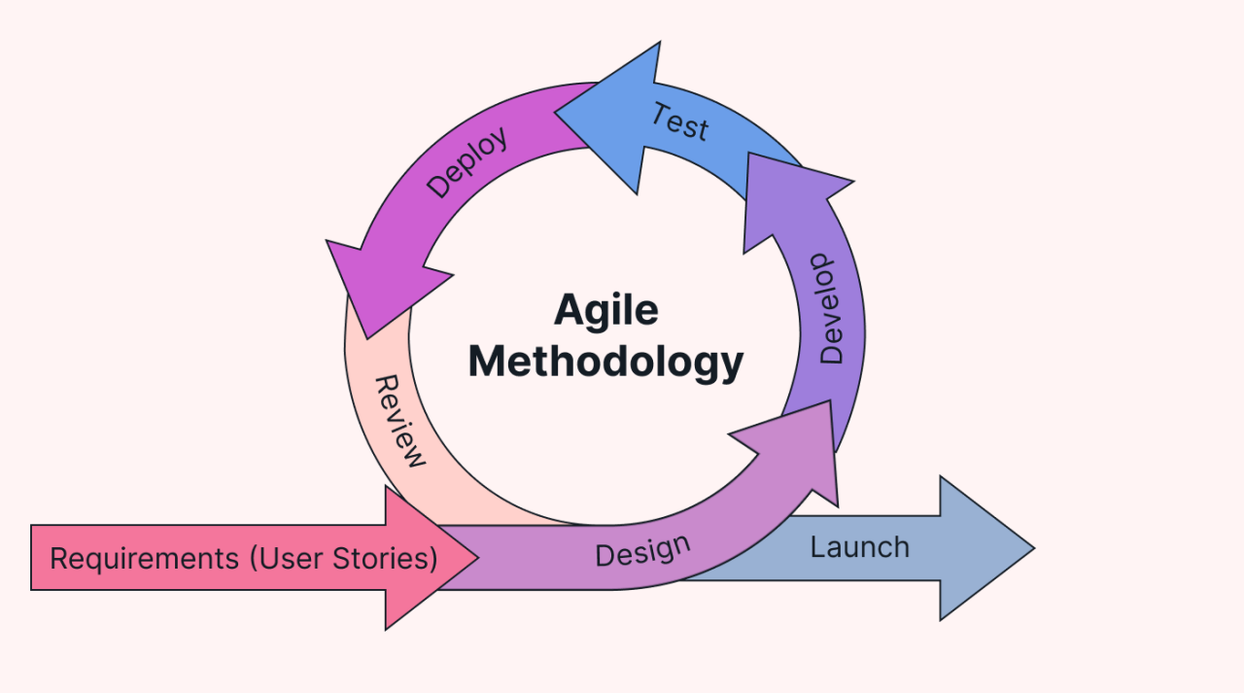

Slide 11
Use-Case Diagram
05

Slide 12
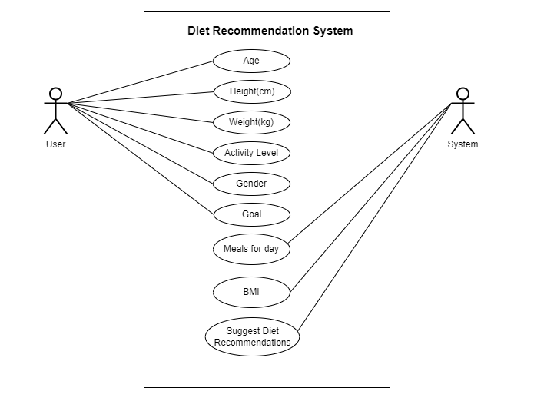

Slide 13
System Flow
06

Slide 14
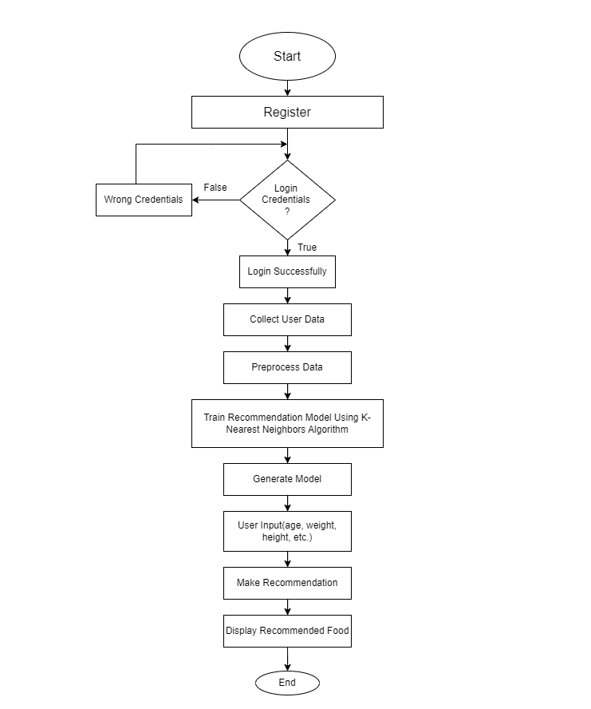

Slide 15
Future Scope
07

Slide 16
Add real-time health data, DNA information, and eating habits for more accurate advice.
Update diet plans daily based on changes in activity and health.
Connect with fitness trackers to continuously monitor health metrics like heart rate and exercise.
Use user feedback to improve and personalize future recommendations.
Offer more diet options like vegetarian, non-vegetarian, and vegan for better variety.
Track food choices based on specific health issues like diabetes, blood pressure, and other conditions.

Slide 17
Conclusion
08

Slide 18
In conclusion, we’ve developed a personalized diet software using AI and machine learning that tailors meal plans based on user details like age, gender, weight, and health goals. By analyzing a medical dataset, it provides customized diet advice, helping users lead healthier lives. The study shows the potential of such algorithms and suggests future enhancements by including additional factors like lifestyle, physical activity, and medical history for even more accurate recommendations.

Slide 19
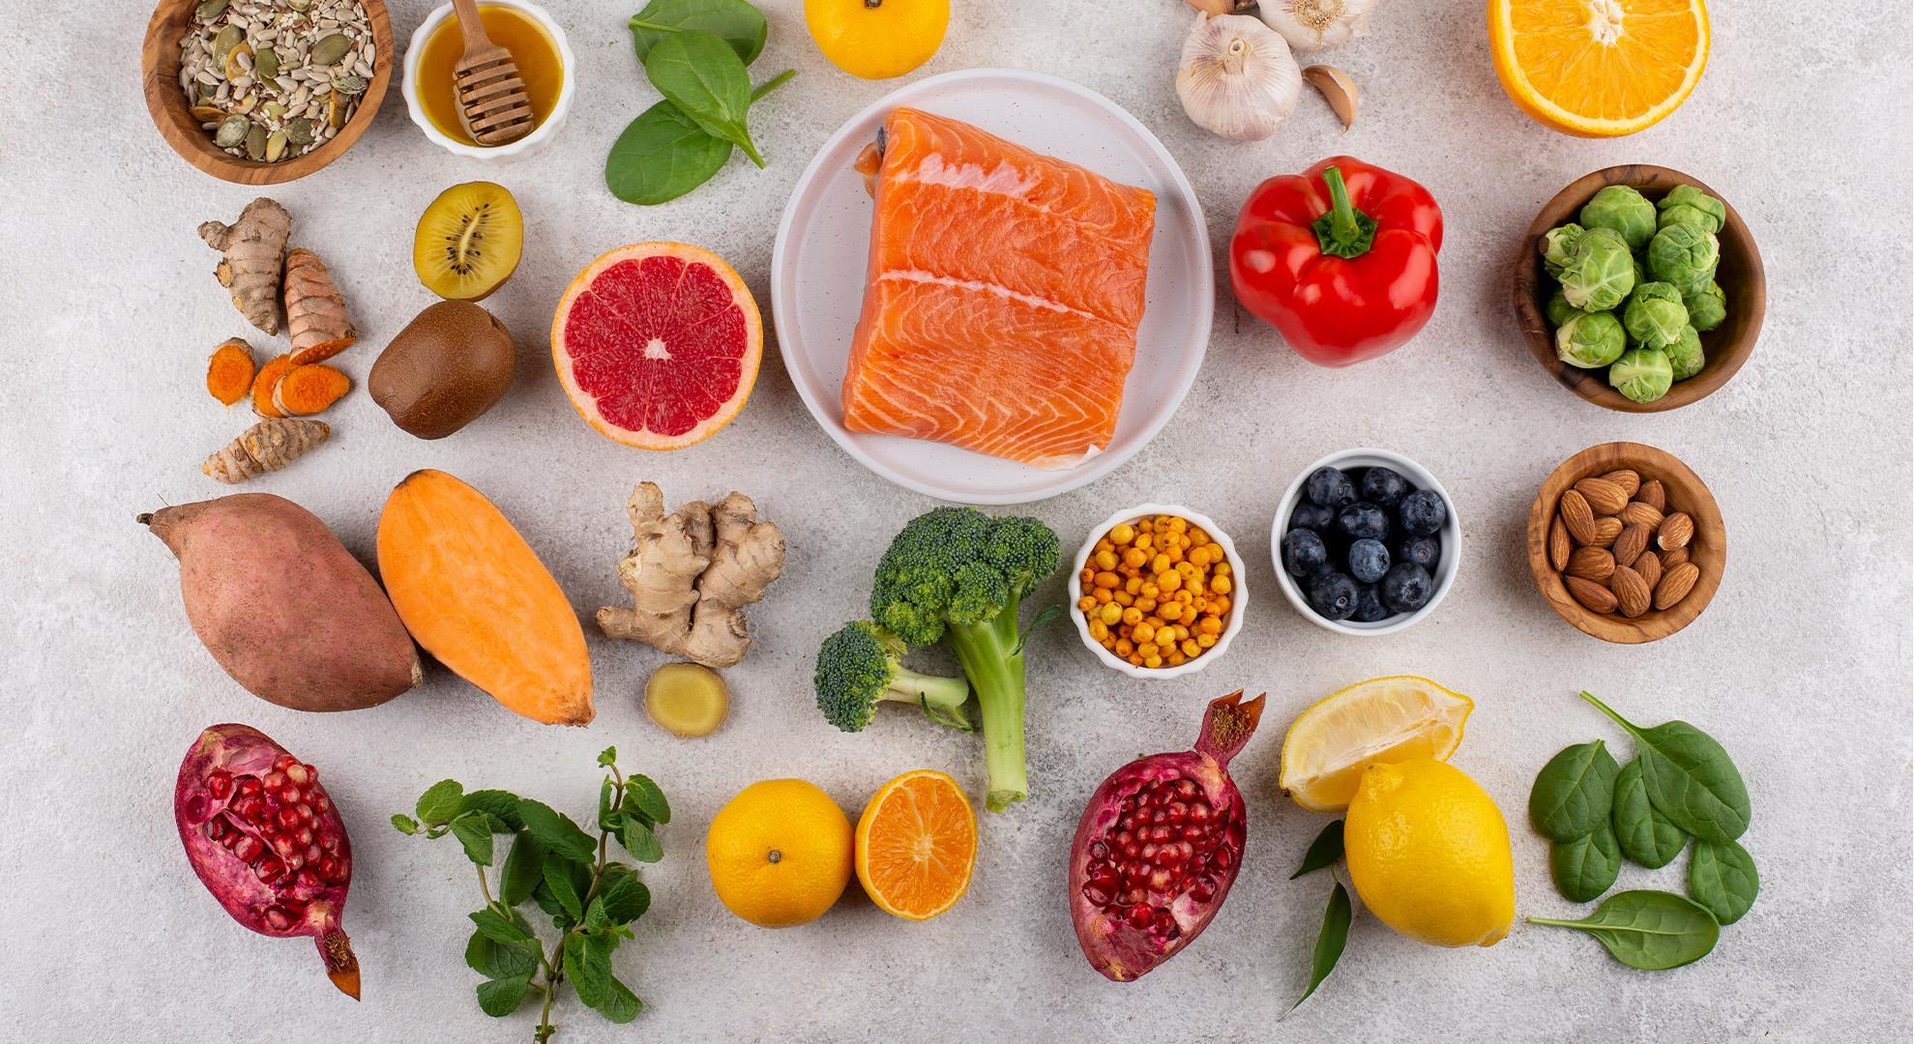
Thankyou !!!

